Slide 1
SunSpot CyCLE AnAlysis in PSPT Data
CSCI 7000 Semester project
Jamie Mothersbaugh, LASP, CU Boulder

Slide 2
SUNSpot Background
A sunspot is a region on the photosphere (surface of the Sun) that appears darker than the surrounding photosphere
Sunspots are caused by an increased localized density of magnetic flux that prevents photons from reaching the photosphere
The frequency of sunspots rises and falls in a ~11 year period called the solar cycle
The solar cycle is correlated with how ”active” the Sun is- sunspots, flares, coronal mass ejections, etc. Sunspot frequency could also correlate with climate on Earth- during the Maunder Minimum period in the 1600s, an almost total lack of sunspots is thought to have caused colder weather on Earth
Sunspots have been observed and recorded since the 1600s- the complete sunspot data record is one of the oldest astronomical data sets

Slide 3
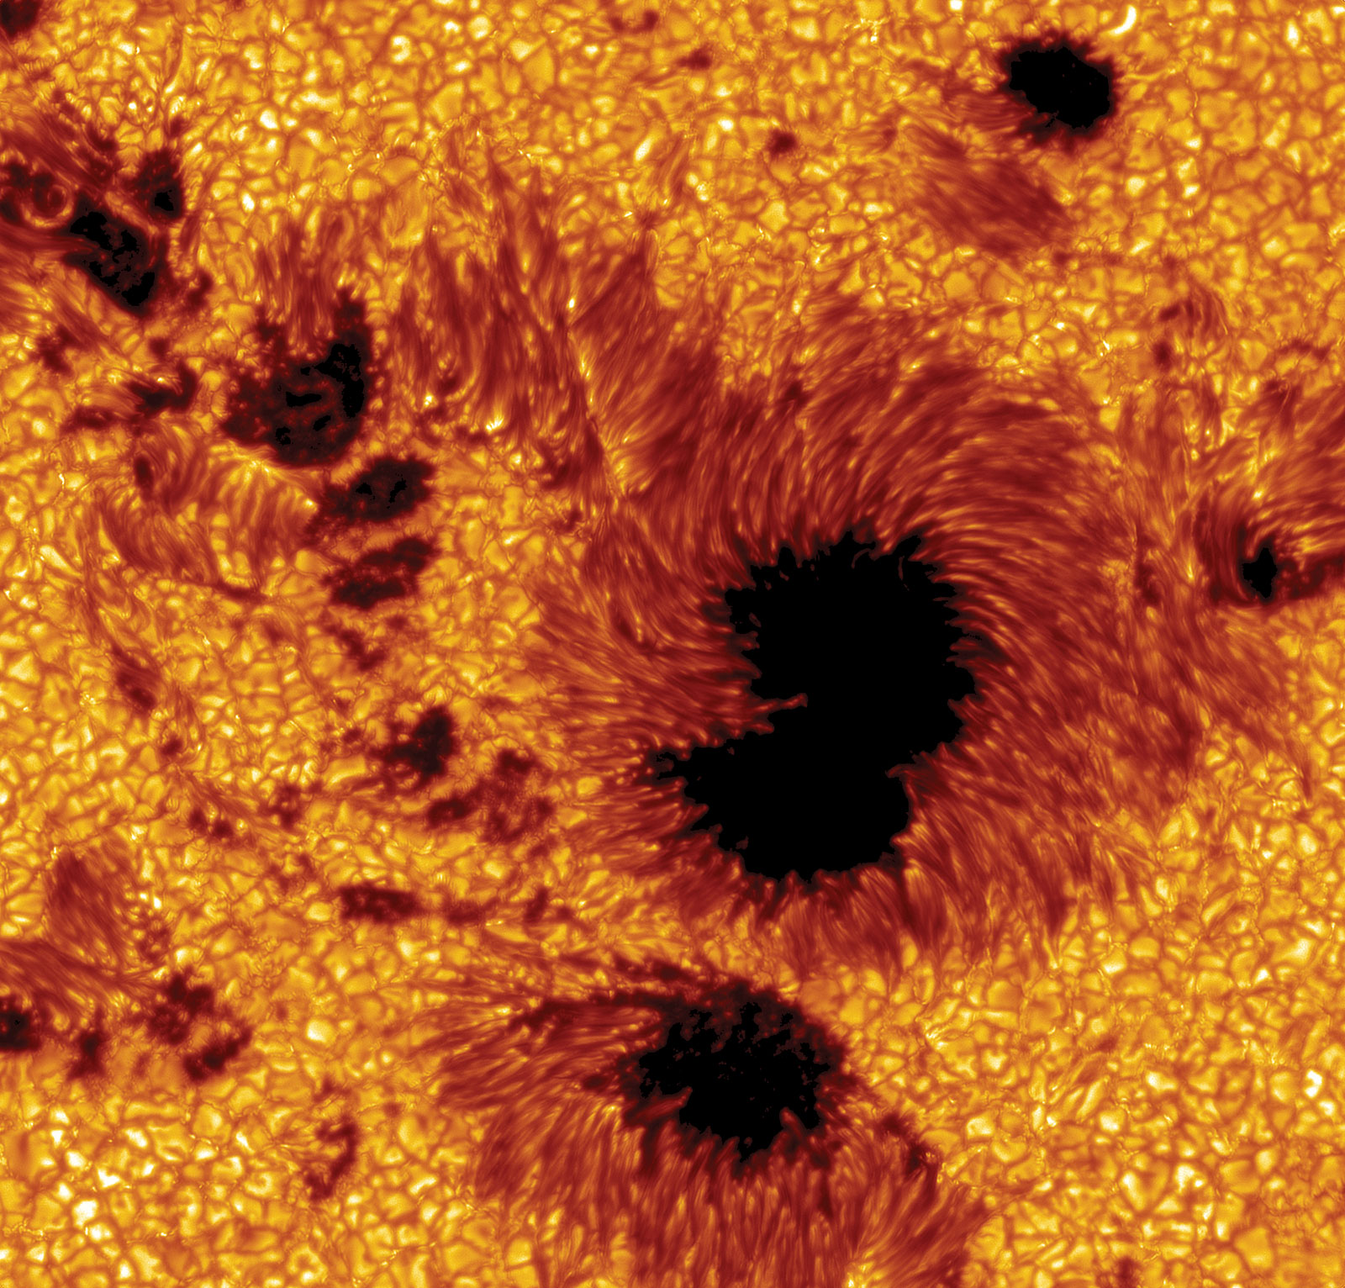
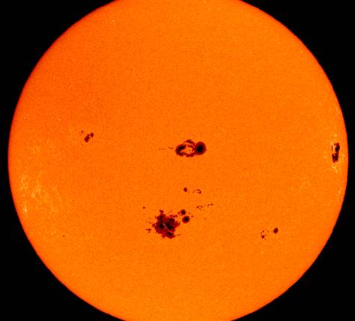

Slide 4
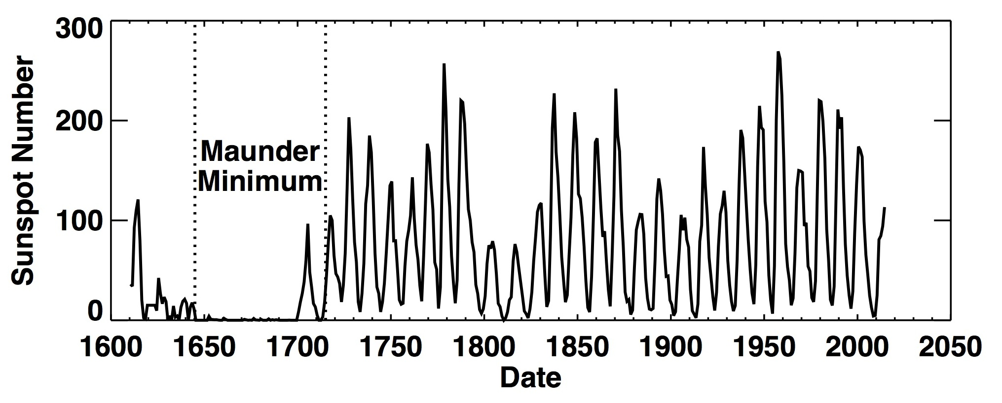

Slide 5
PSPT data record
PSPT (Precision Solar Photometric Telescope) was a visible-light telescope on Mauna Loa in Hawaii. It took images of the Sun with 3 different filters at 393nm (calcium), 409nm (blue light) and 607nm (red light). It took ~daily data from March 1998-June 2015.
I did analysis & processing of the 1998-2004 data at LASP
Because the images were taken in visible light, sunspots are apparent in the data
My project will analyze the entire PSPT image record in all 3 filters, track the sunspots in the images as a function of time and compare to the known sunspot data record
How complete is the PSPT data record with respect to sunspots? Can the sunspot cycle be reasonably derived/inferred from the 17-year PSPT data record?

Slide 6
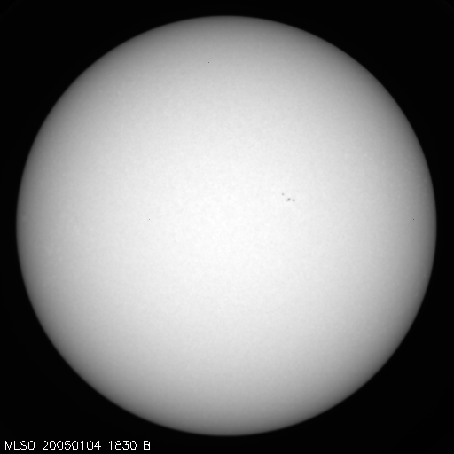
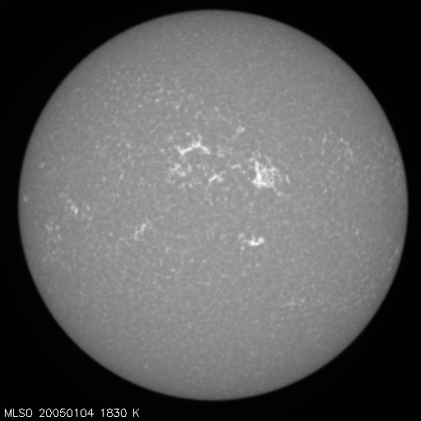

Slide 7
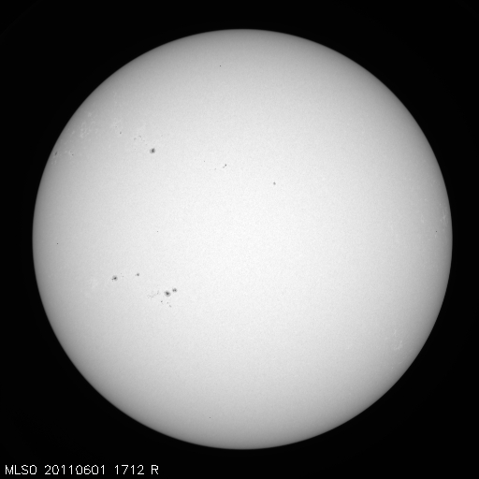
Previous images show blue & calcium images from January 2005, near solar minimum. Image below is a red from June 2011, near solar maximum. The increase in sunspots is clear in the image.

Slide 8
Data
PSPT data is publicly available for download at http://lasp.colorado.edu/pspt_access/
Data includes FITS (Flexible Image Transport System- common data type for astronomical image data) and JPG files of images in 3 different filters on a daily cadence; often multiple files per day are available
Data acquisition via existing download tools is fast and convenient- any outside user can obtain the data with ease
FITS images can be read into Python and converted to an array- this makes analysis and software applications straightforward
FITS images also contain a header with metadata information about the image- timestamp, dimensions, etc.
The sunspot size & intensity will vary depending on which wavelength is observed
(continued)

Slide 9
Part of a PSPT FITS header is shown below.
DATE = '2005-11-11T00:58:50' / Date this header defined ORIGIN = 'MLSO ' /Location image acquired TELESCOP= 'PSPT ' /Imaging telescope INSTRUME= 'Xedar 2k x 2k 12 bit' /Imaging instrument-camera TEMP = '26C ' /Camera temperature OBS_PROG= 'SunRISE ' /Observing project OBJECT = 'FULL DISK' /Object observed DATE_OBS= '2005-10-31T17:05:07.433Z' /Starting date-time of obs. DATE_END= '2005-10-31T17:10:18.013Z' /Ending date-time of obs. EXPTIME = 0.0360000000000 /Exposure time in seconds, per frame WAVELNTH= 607.097 /Wavelength of observation (nm) FWHM = 0.458000 /Filter full width at half max OBS_TYPE= 'RCONT ' /Type of observation

Slide 10
software
Sunspots can be determined from the FITS images by analyzing the brightness values of the image array- once a sunspot is identified in the array, it can be cross-referenced with the JPG image to verify the accuracy of the code checking the array
Data structures will be used for storing the sunspot data as a function of time- this is a large data set!
A time series of the data will be constructed by parsing the information in the header and storing the date & time of the image
Plotting and image visualization will be essential for displaying the data and determining the accuracy of the results
All 3 filters will be used to generate a sunspot record from the data- this can then be compared to the existing sunspot record. The sunspot record obtained by the code may vary depending on which filter is observed.
Additionally, a function can be fit (using Python scipy or similar packages) to the calculated sunspot data- how well does that function compare to the existing sunspot record?

